Slide 1
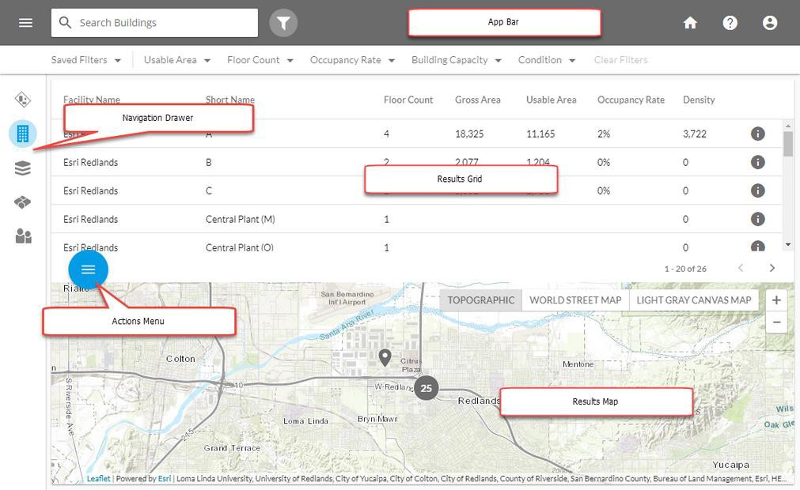


Space Manager
Search and Filter View
Navigation Drawer - Select entity types (Buildings, Spaces) to view in the Results Grid and Results Map
App Bar - Search, Filter, and Navigate to Home
Results Grid - View and sort records for each Entity Type; drill down to details view
Results Map - Show the location of records for the selected entity type on a map
Actions Menu - Share a link or make Bulk Edits to data displayed in the Results Grid

Slide 2

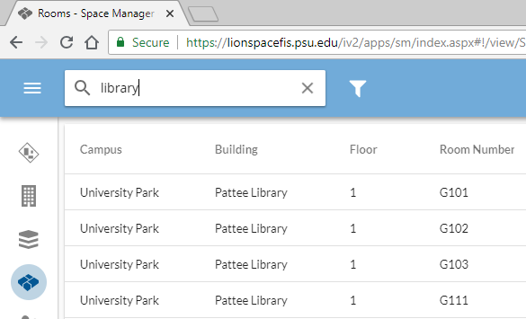

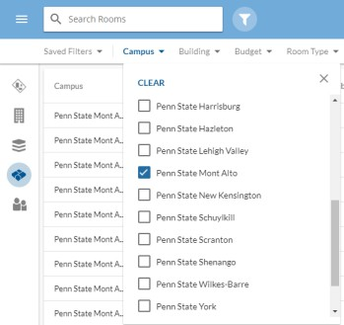

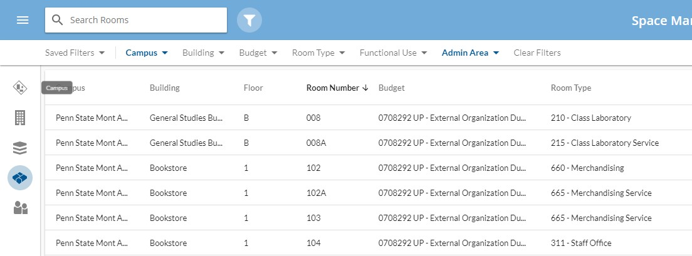

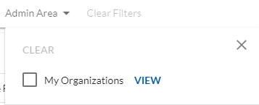
Space Manager
Searching, Filtering, and Sorting Data
Free-text Search
Create a Filter
Sort Results
NEW! My
Organization
Penn State University Facilities Resources & Planning
penbaysolutions.com

Slide 3


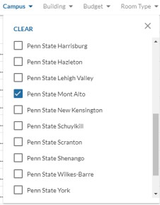
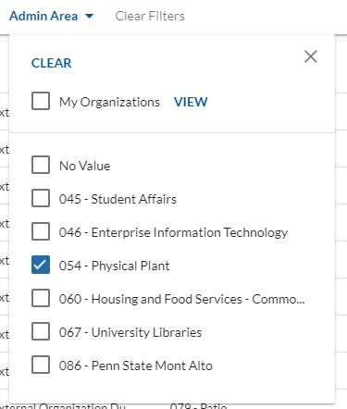

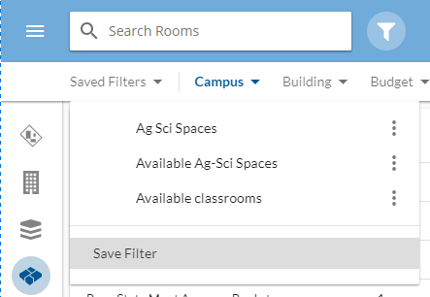

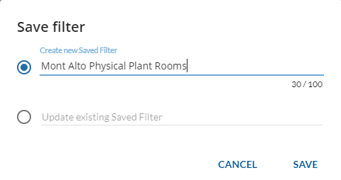
Space Manager
Saving Filters and Creating KPIs
Create a filter (e.g., Campus = Penn State
Mont Alto, Admin Area = 054 – Physical Plant)
Click Saved Filters -> Save Filter
Name your filter (e.g., Mont Alto Physical Plant
Rooms)
Click Save

Slide 4
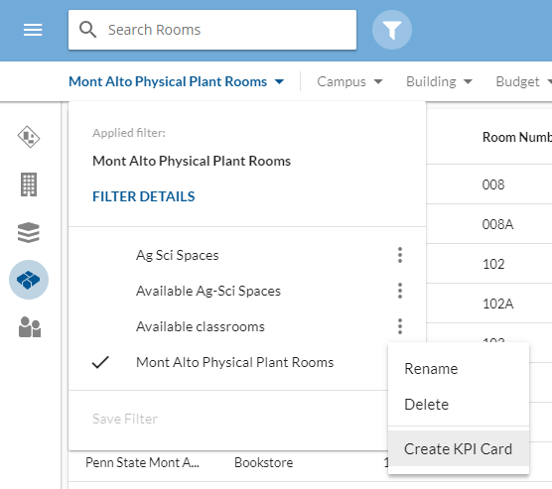

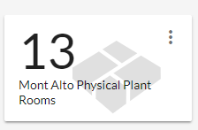
Space Manager
Saving Filters and Creating KPIs
Select Filter Name
Click Create KPI Card
Click View Card or go to InVision Home and view / manage card attributes

Slide 5
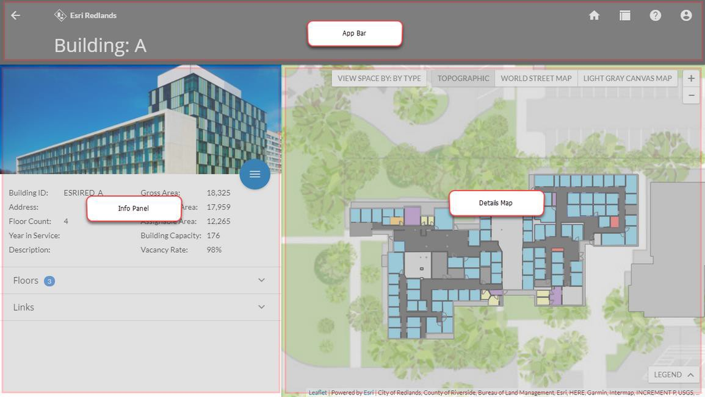
Space Manager
Details View: Viewing Building, Floor, and Space Records
App Bar
Traverse the facility hierarchy, go back HOME, or switch Layout Mode
Info Panel
Display detailed information about facilities, show related entity types and, perform other operations like editing, printing, reporting
Details Map
Show data on the map, select features, create user- defined view-bys, view legend

Slide 6
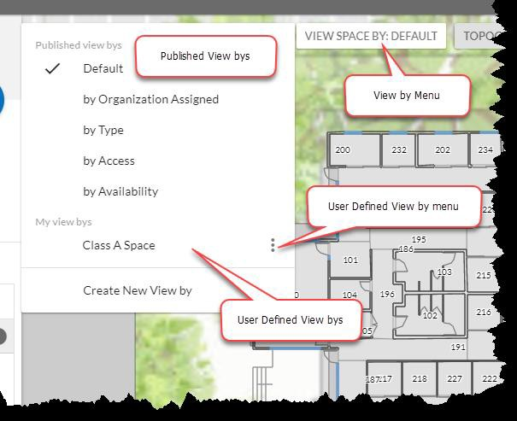
Space Manager
View-By’s
Published View-By
Whenever a Floor is visible in Details View, users can select the active viewby from the View-By control in the map. The standard View-By’s listed at the top of the picklist are Published View-By’s which everyone across the organization can see.
User-Defined View-By
When a user creates a User-Defined View-By, they are listed below the Published View-By’s in the drop-down. There is also a menu item at the bottom of the drop-down to Create a new User-Defined View-By.

Slide 7
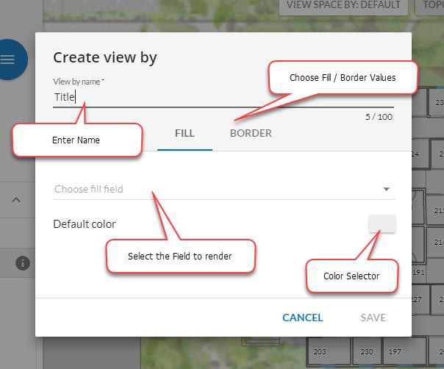
Space Manager
View-By’s
To Create a User-Defined View-By:
1.
Select the Create New View-By menu item at
the bottom of the View-By Menu.
Enter a name for your View-By
Choose an attribute to use for a “fill” color. Check or un-check values you want to see colored in the map.
Click “Border” Choose an attribute to use for a “border” color. Check or un-check values you want to see colored in the map.
Click “Save”.
2.
3.
4.
5.
Notes:
Default colors represent the default color of records not being rendered in your User-Defined View-By.
User-Defined View-By’s do not change when you move from floor to floor or building to building.

Slide 8



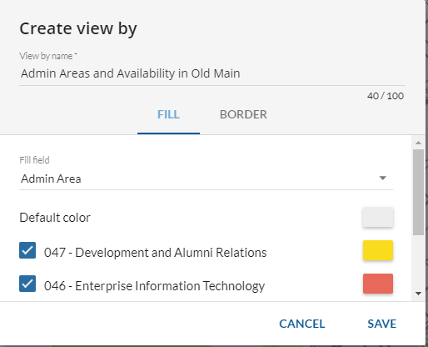
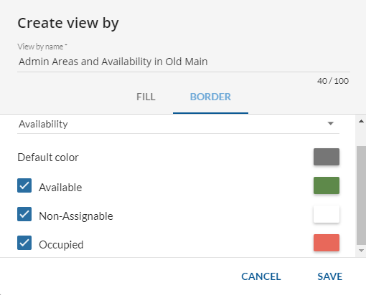
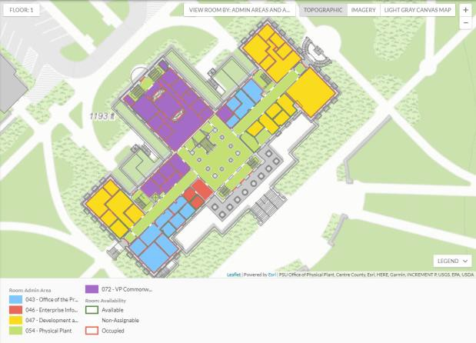
Example: Admin Areas by Availability in Old Main

Slide 9

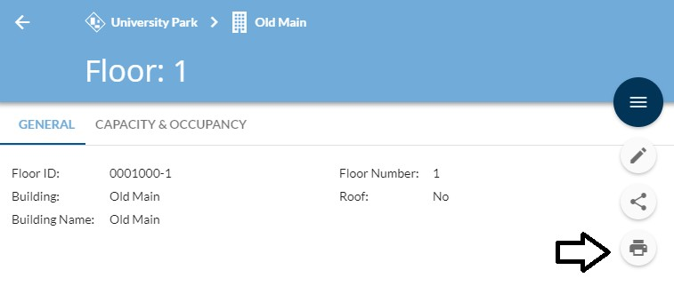

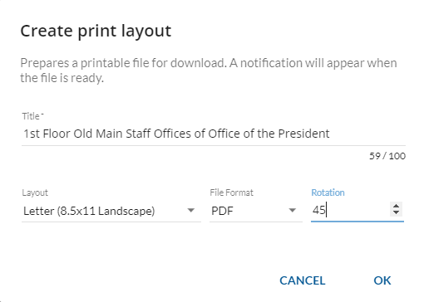




Space Manager
Printing Maps
From the Actions Menu in Details View, select the Print action
Specify the following variables:
  Title - Specify a title (e.g., 1st Floor, Old Main)
  Layout - Select a layout (e.g., 8.5x11)
  File Format - Select a file format. Default is .pdf
  Rotation - Optional value - By specifying a rotation value, you can rotate the floor to a preferred orientation.
Click OK.
A message will appear at the bottom of the screen to show you the status of the print task, and notify you when the task is done. From this message you can download your final Print Layout.
penbaysolutions.com

Slide 10

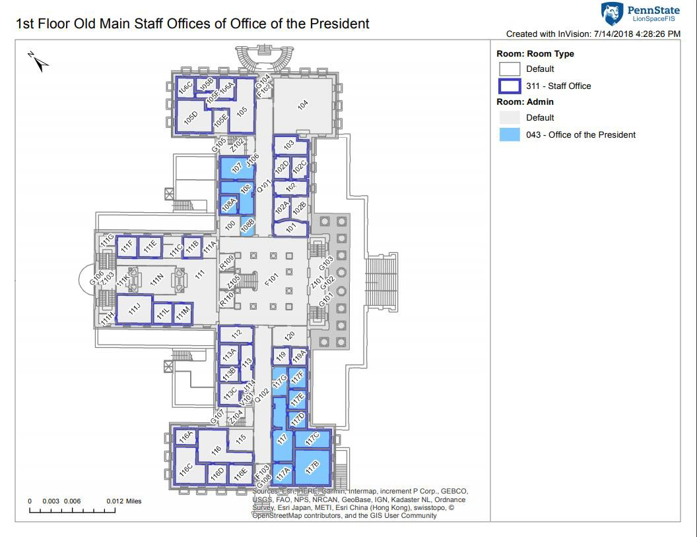
Space Manager
Printing Maps
Printed map will appear in layout with title, legend, and rotation specified.
Save or send to printer from your browser, based on your computer settings

Slide 11

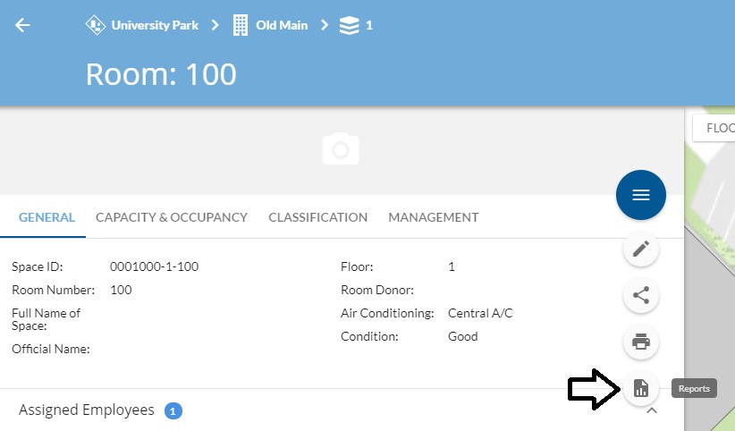

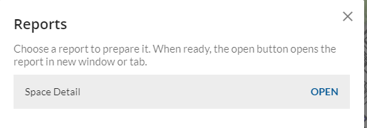

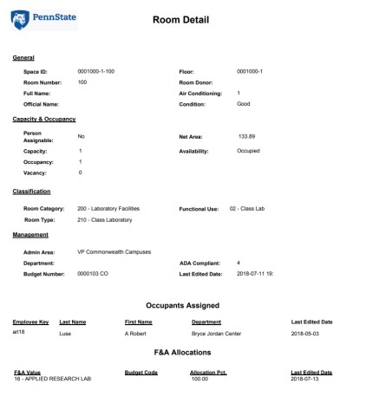
Space Manager
Launching Reports: Single Record Reports
Single Record - Run a quick report for a single record (e.g., Space Detail Report for this room).
  Select the record you want to report on in Details View
  Select Reports from the Action Menu.
  Click on report from the list.
  Wait for it to run.
  Click “OPEN” when it appears.

Slide 12

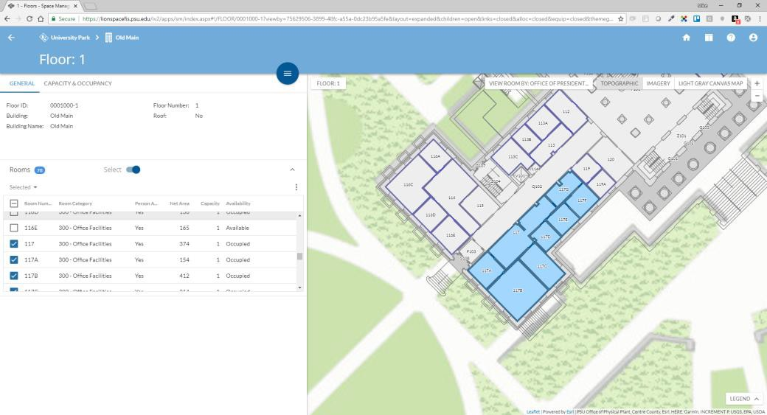
Space Manager
Launching Reports: Selections
Selections – Run a report on multiple, selected spaces.
  Go to the Details view for a Floor.
  Click the “Select” slider, then click checkboxes next to spaces to create a
Space Selection. Note spaces are highlighted on the map.
ies Resources & Planning
Penn State University Facilit

Slide 13

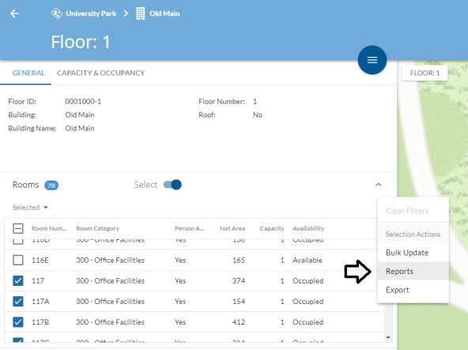

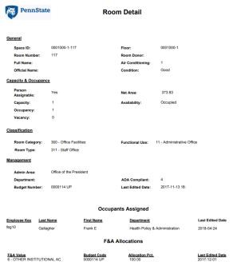
Space Manager
Launching Reports: Selections
Selections – Run a report on multiple,
selected spaces.
  Select the overflow menu in selections sub- panel.
  Launch the Reports dialog.
  Click on report from the list.
  Wait for it to run.
  Click “OPEN” when it appears.
enbaysolutions.com
p

Slide 14

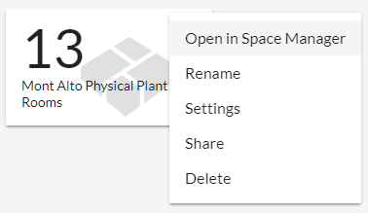

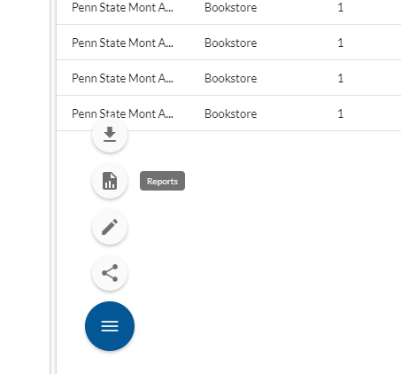


Space Manager
Launching Reports
Filters – Run a report for multiple
records that meet filter criteria.
  Open a KPI Card in Space Manager (or select a saved filter)
  Select Reports from the Action Menu.
  Click on report from the list.
  Wait for it to run.
  Click “OPEN” when it appears.
baysolutions.com
pen

Slide 15
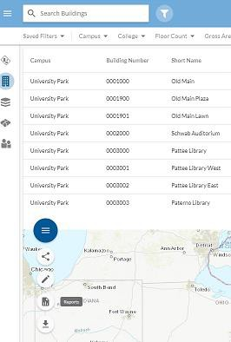
Space Manager
Launching Reports
All Records - Run a report for all records of a given type (e.g., all buildings).
  Select the type of Entity you want to report
on from the left hand panel
  Select Reports from the Action Menu.
  Click on report from the list.
  Wait for it to run.
  Click “OPEN” when it appears.

Slide 16
Space Manager
Launching Reports
Notes:
  Some reports run longer than others, ESPECIALLY if you’re running them for
multiple records
  You can also run reports from InVision Home

Slide 17

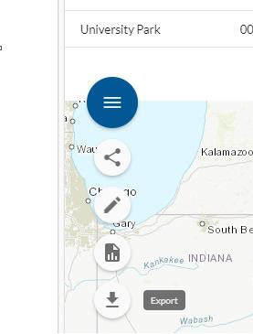



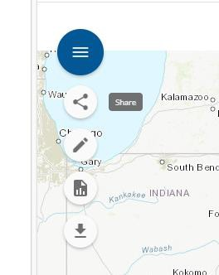

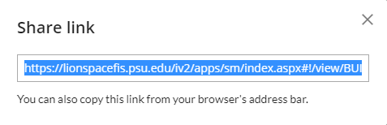
Space Manager
Export to Excel, Sharing
Export to Excel
  In Search and Filter view, select Export from the Action Menu.
  Whatever records are visible in your current Search and Filter criteria, they will be exported in their entirety.
  Click DOWNLOAD when file is ready.
Sharing Links
  Anywhere in the application, select Share from the Actions menu.
  Copy the hyperlink.
  Save it, email it, Skype it, whatever!
  Anyone else who clicks on that URL will be taken to the exact same app / view you see.
penbaysolutions.com

Slide 18

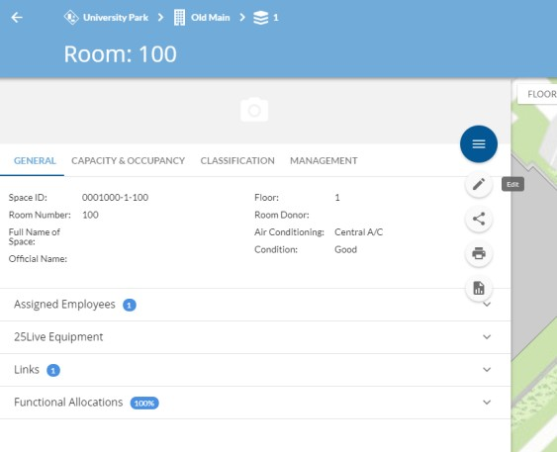

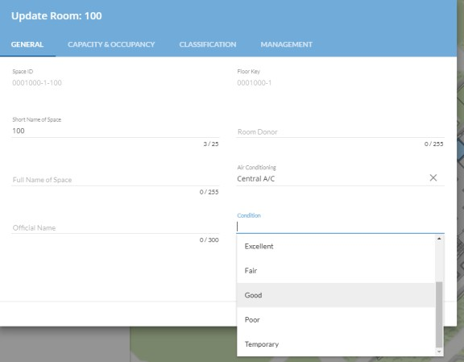
Space Manager
Editing Individual Records
When you need to update or enter information for an individual record:
  Go to Details View for record you want to update
  Select Edit from the Actions Menu
  Find data to update using tabs
  Click SAVE
Notes:
Fields in gray are visible for reference but not
editable
Fields that participate in a hierarchy are indented
Tabs match the tabs in the Info Panel
penbaysolutions.com

Slide 19


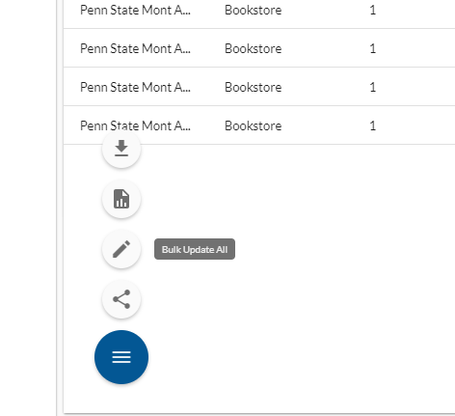
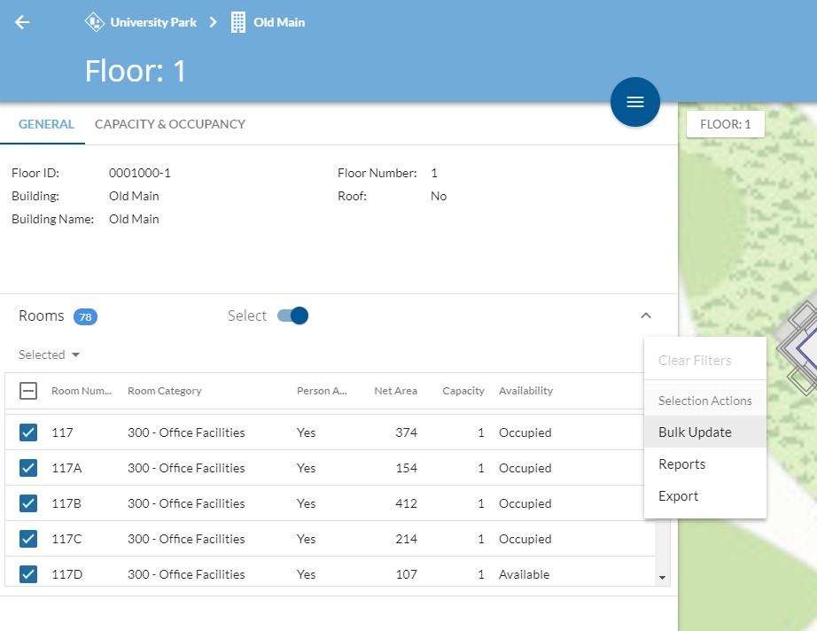
Space Manager
Bulk Editing Records
From Search and Filter View
From Selected Spaces
penbaysolutions.com

Slide 20
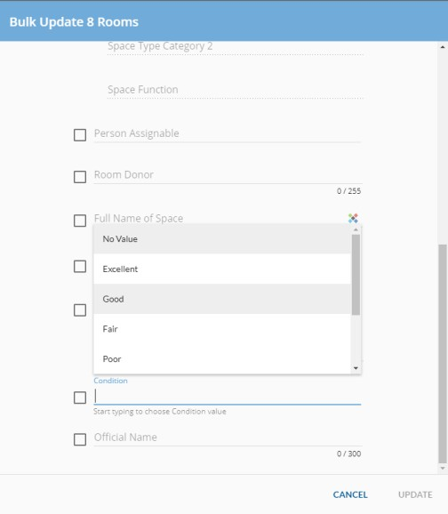
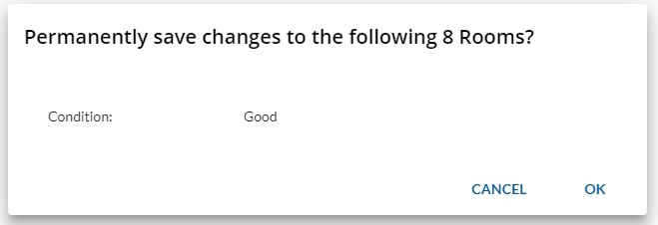
Space Manager
Bulk Editing Records
From Search and Filters View, or from Floor Details View with Selected Spaces:
  Select Bulk Update from Actions Menu
  Edit attributes
  Click UPDATE
  View “permanently save” dialog to confirm
edits
  Click OK
Note:
Same changes will apply to all spaces in your filter or selection.
No “UNDO” capability

Slide 21

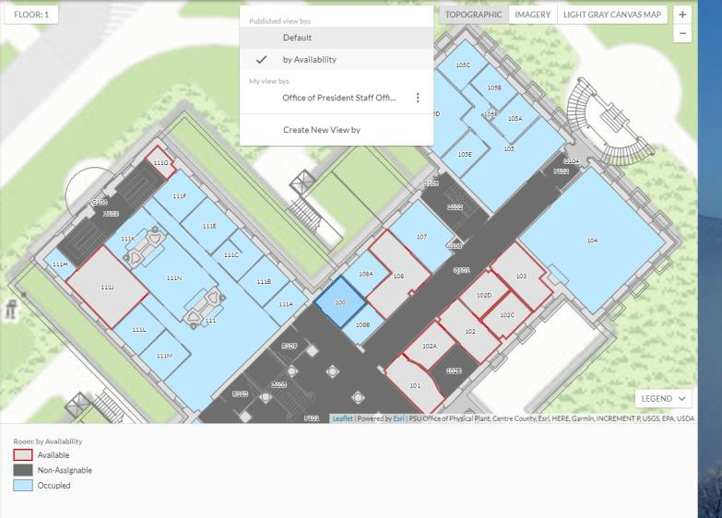
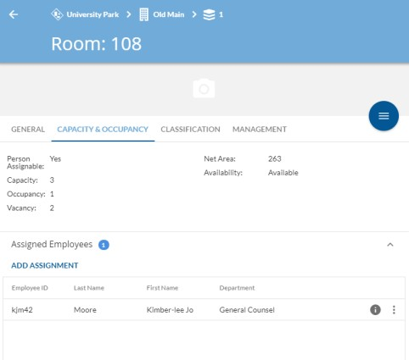
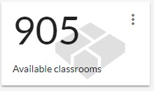
Space Manager
Assigning Occupants
Getting Context:
  KPI Cards
  Search and Filter View
  Floor Details view for building of interest and
select “by Availability” published view by
  Capacity and Occupancy tab of individual spaces

Slide 22


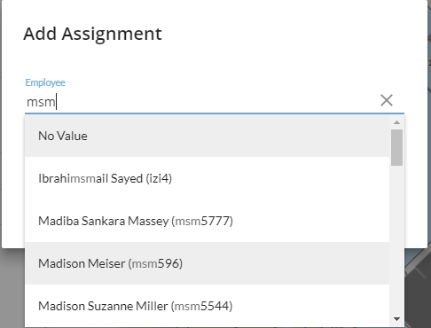

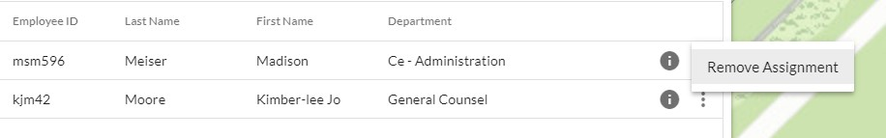
Space Manager
Assigning Occupants
To Assign Occupants:
  In Space Details view, expand “Assigned Employees” sub-panel and click “ADD ASSIGNMENT”
  Start typing username, then select result from the dropdown list that appears
  Click SAVE
  Details panel will update with new occupant, including Occupancy and Vacancy attributes.
  Can remove occupant by clicking overflow menu in selections sub-panel and selecting “Remove Assignment.
penbaysolutions.com

Slide 23

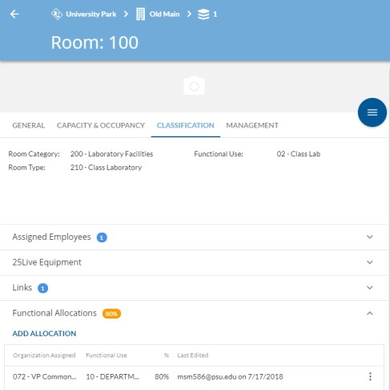

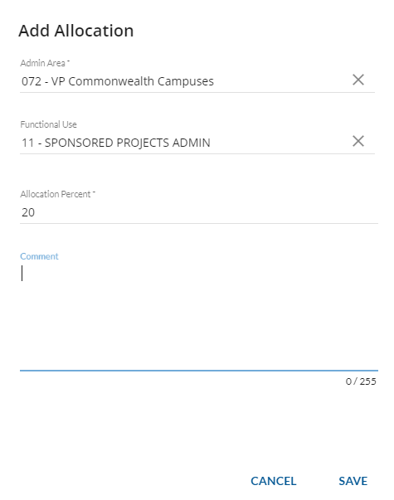
Space Manager
Functional Allocations
To assign Functional Allocations:
  In Space Details view, expand the Functional Allocations sub-panel.
  Click ADD ALLOCATION.
  Select an Admin Area, Functional Use,
and Allocation Percent.
  Click SAVE.

Slide 24

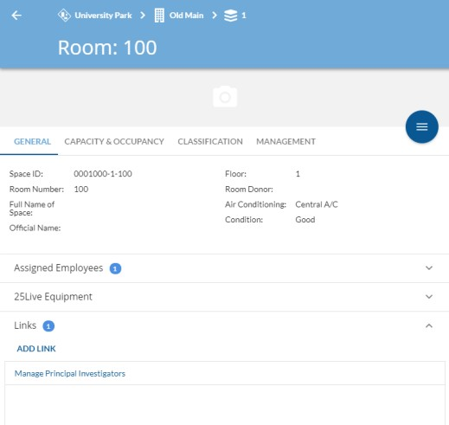


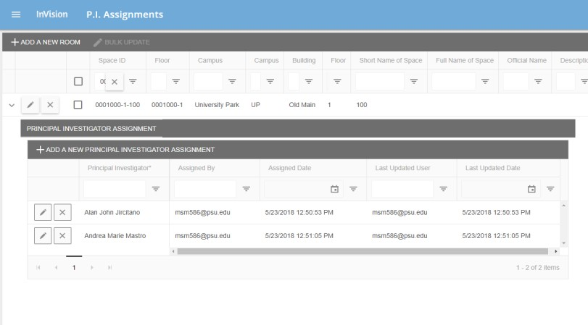

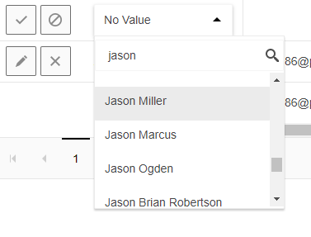

Space Manager
Assigning Principal Investigators
In Space Details View:
  Expand the Links sub-panel. Click Manage Principal Investigators. P.I. Assignments app will open.
  Click down-arrow next to space. Principal Investigator panel will open.
  Click + ADD A NEW PRINCIPAL INVESTIGATOR ASSIGNMENT. Type name of Principal Investigator into Principal Investigator dialog and select them from the list.
  Click the to save

