Slide 1
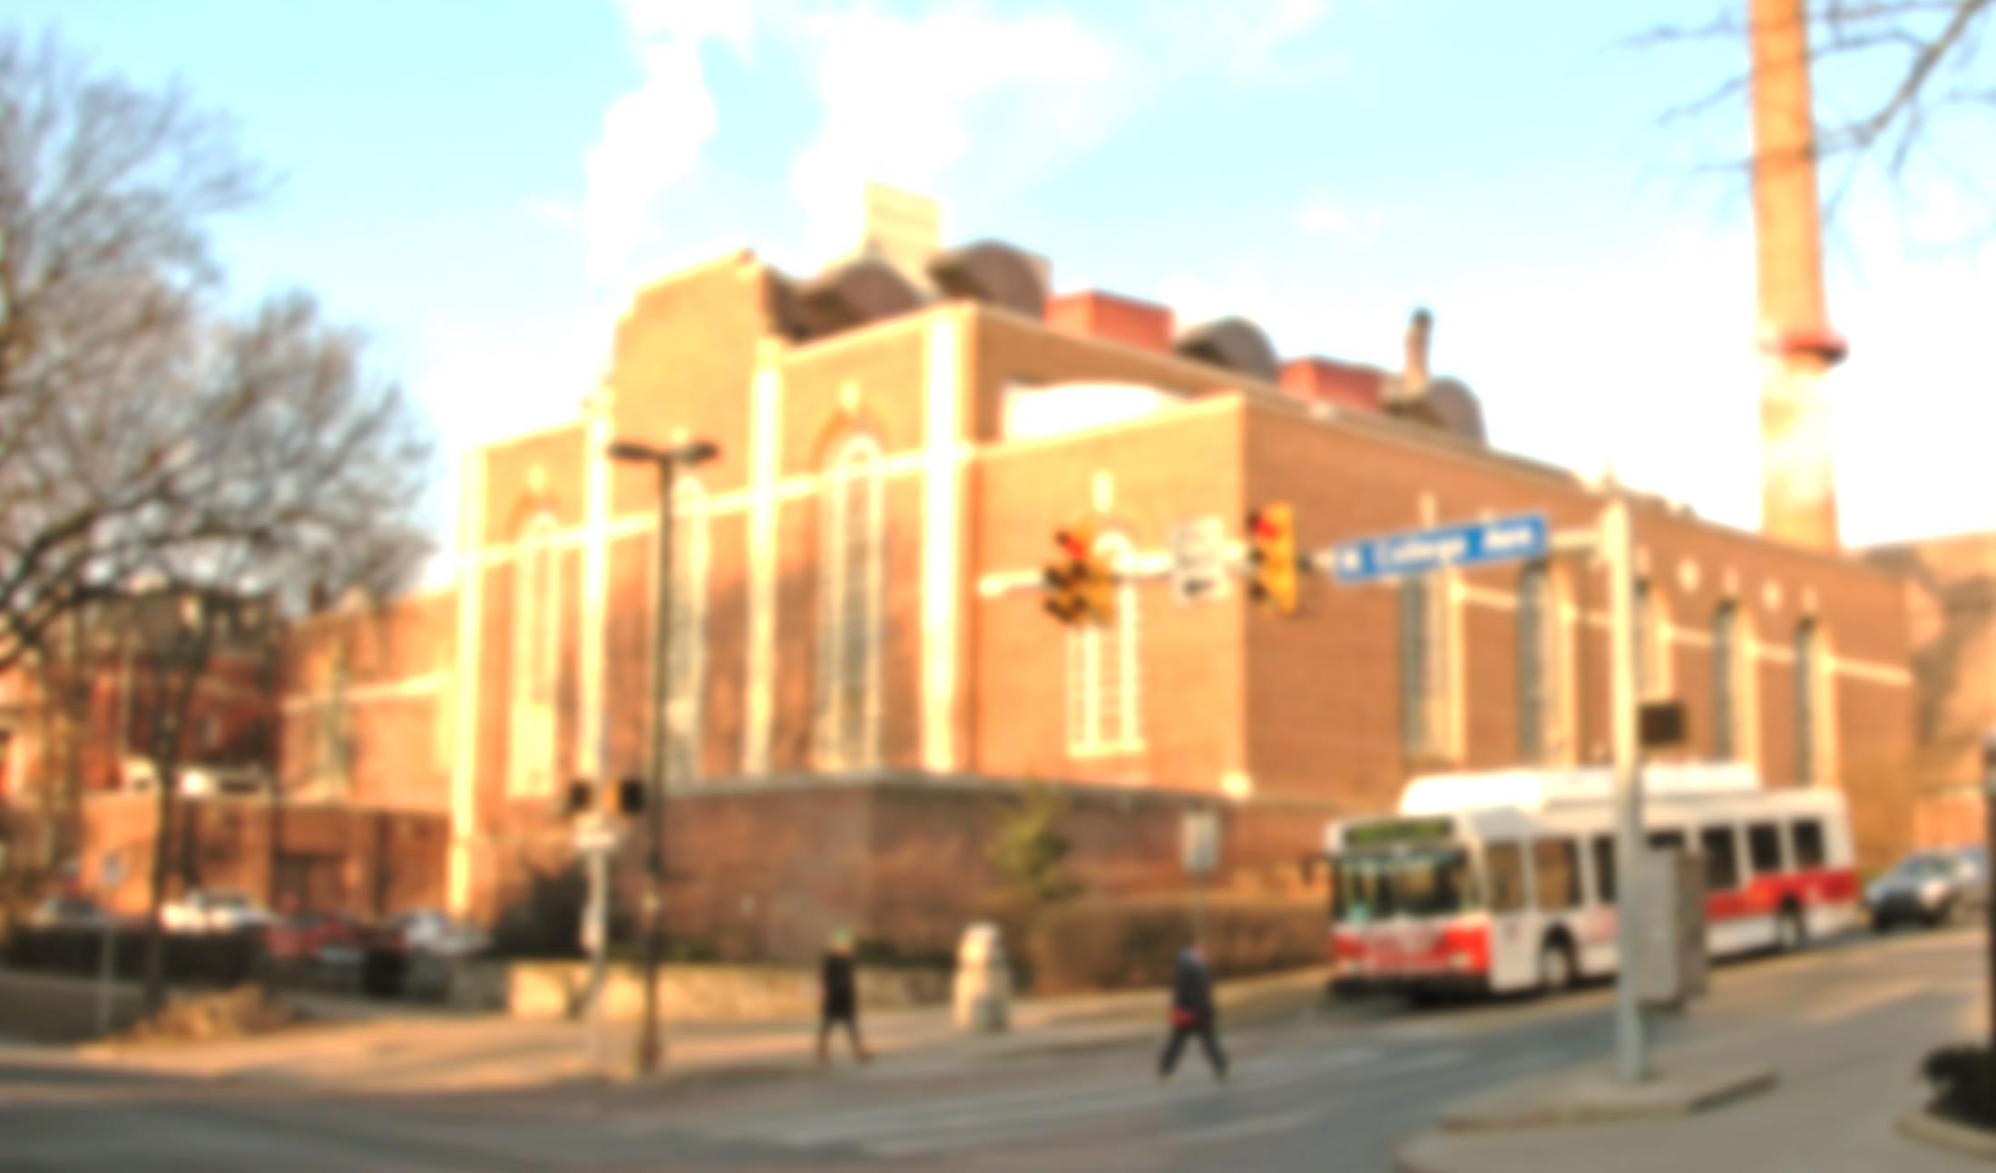
Penn State University
Steam Services
Safety Orientation

Slide 2
Paul Moser, P.E. 814-321-3760 Superintendent – Steam Services Penn State University

Slide 3
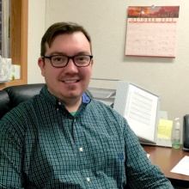
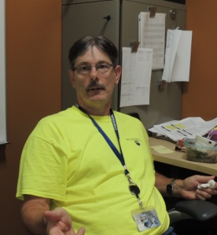
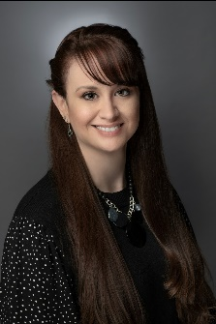
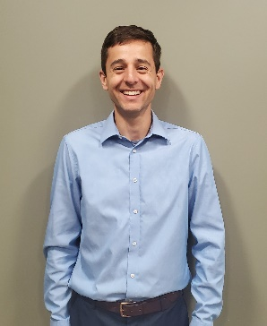
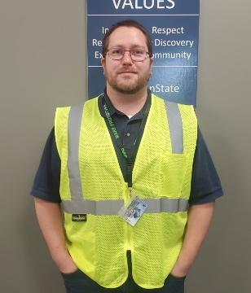
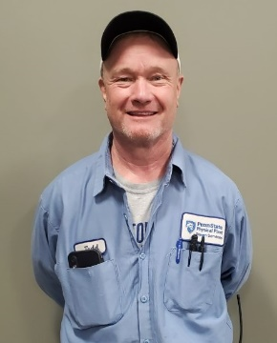
Steam Services Leadership
Paul Moser
Superintendent
814-321-3760
Power Plants
Staff Assistant
Distribution
Steve Nelson
Lead Maintenance Mechanic - Steam Plants
814-777-3154
Katie Deitrich
Administrative Support Specialist
814-865-6515
Vinny Hood
Steam Distribution Supervisor – Steam Distribution
814-571-3263
Tim Patterson
Supervisor – Steam Plants
814-810-8053
Todd Campbell
Lead Distribution Mechanic – Steam Distribution
814-777-0546

Slide 4
Important Phone Numbers
Emergency 911
Steam Services, Main Plant 814-865-6515
OPP Safety Office
George Benko 814-421-8412
Don Fronk 814-937-9873
Environmental Health & Safety 814-865-6391
Spills / Leaks
Hazardous Waste Handling

Slide 5
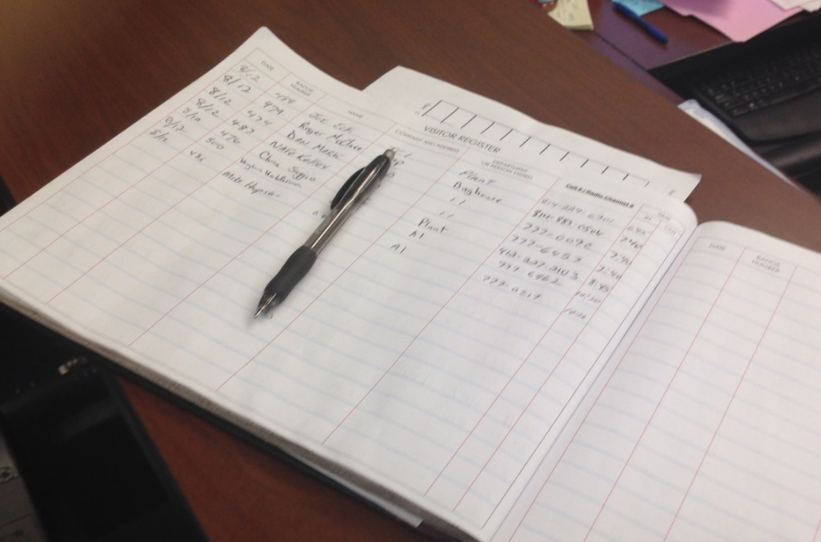
Sign in / Sign out
All visitors MUST sign in and out of the plant at the main office
All visitors MUST provide a mobile number or radio channel where they can be reached while on site.

Slide 6
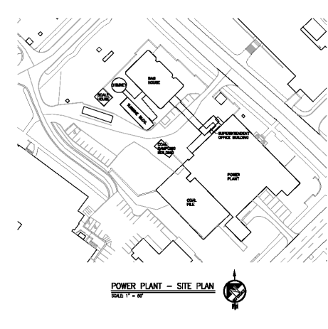
Evacuation Plan
Take time to orient yourself inside the plant. Maps are posted throughout the plant and exits are clearly marked.
In the unlikely event the West Campus Steam Plant must be evacuated, you will hear this sound:
Immediately exit the building from the nearest location.
Report to the Muster Point shown on the site map to the right.
Steam Services Leaders will be at the muster point with the visitor sign-in log to verify everyone has been evacuated.
Muster Location on macadam Alley. North of WCSP.

Slide 7
Safety Policies
Personal Protective Equipment
Lockout / Tagout
Confined Space
Electrical Safety – NFPA 70E
Fall Protection
Aerial Lifts
Hot Work
Fork Truck Operation

Slide 8
Parking
There is no personal vehicle parking at West Campus Steam Plant.
Work vehicles parked at either WCSP or ECSP must be approved by Steam Services Leadership and require a parking permit.
Parking Permits are required at both East and West Campus Plants and can be obtained from the Parking Office.
PSU Parking Office - Permits

Slide 9
Personal Protective Equipment PPE
Hardhats and safety glasses are required
AT ALL TIMES with the following Exceptions:
Offices, Control Rooms, Break rooms
Safety toed shoes are required for all personnel working in the plant
Highly recommended for visitors
Safety toe caps are available
Hearing protection is provided and required everywhere inside WCSP and in other designated areas
Additional PPE required for specific jobs.

Slide 10
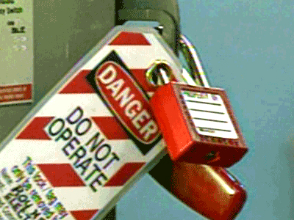
Lockout / Tagout
Lockout/TagOut is a program to ensure
worker protection against energy
sources during maintenance work.
Steam Services has detailed Lock/Tag program that must be followed. See your leader for details.
Everyone must have and use their own lock and tag when working on any piece of equipment. No one is permitted to work under or remove some else’s Lock/Tag.
Personal locks shall be immediately removed following the completion of your work.

Slide 11
Confined Spaces
A confined space is a work area that is enclosed or partially enclosed, not intended for continuous occupancy, and has limited means for entry or exit.
Examples include: Inside boilers/ furnaces, manholes, silos, large pipelines, etc.
All confined spaces require a completed permit by an authorized Entry Supervisor
Dedicated Safety Attendant is required at all times
Air monitoring equipment shall be calibrated and in use at all times

Slide 12
Electrical Safety
Electrical Safety is defined by NFPA 70E
Energized work is not permitted without PSU approval using Energized Work Permit form
Appropriate Arc Flash gear must be used for troubleshooting and testing LIVE equipment.

Slide 13
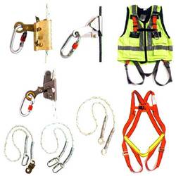
Fall Protection
Fall protection is required for all work above 6 feet.
Protective handrail and personal fall arrest systems must meet OSHA requirements
Floor openings, pits, & excavations must be guarded against falls

Slide 14
Aerial Lifts
Aerial Lift Certification IS REQUIRED to operate an aerial lift.
Contractors are not permitted to operate PSU aerial lifts.

Slide 15
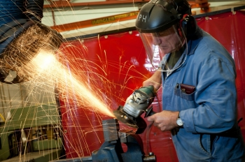
Hot Work
Hot Work permits are required for all welding, brazing, torching, soldering and cutting where combustible material is present.
Only trained employees can perform this work

Slide 16
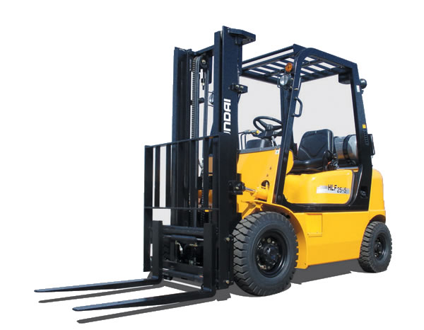
Fork Truck Operation
Fork Truck Operation Certification IS REQUIRED to operate a Fork Truck.
Contractors are not permitted to operate PSU fork trucks.

Slide 17
Asbestos
DO NOT attempt to handle asbestos.
There is asbestos in both East Campus and West Campus Steam Plants.
If you come in contact with insulation that could be asbestos, contact Steam Services Leadership immediately.
Asbestos contractors must be on PSU approved vendor list.

Slide 18
Tours
General Information
All tours must be scheduled through Steam Services Personnel.
Do not wander around the site.
Except for handrails, Do NOT touch anything.
Someone with extensive Steam Service’s experience will lead your tour. Stay close to your leader. Don’t get separated from your group.
Required Clothing
If you don’t have your own, you will be provided Personal Protective Equipment [PPE] including Hardhat, Safety Glasses and Hearing Protection. You must wear them at all times.
No open-toed shoes.
Cotton Clothing is recommended.
Photographs
Photographs are permitted.
Do not take pictures of anyone without their permission.
Backpacks
You are responsible for your belongings. There is no secure place to stow them.
Questions
We encourage your questions. The people who work here are experts and proud of their facility. They will be happy to assist you and answer all your questions.

Slide 19
This completes Penn State Steam Services’ Safety Orientation Program. If you have questions, please contact Steam Service’s Leadership. Thank you.

