Slide 1


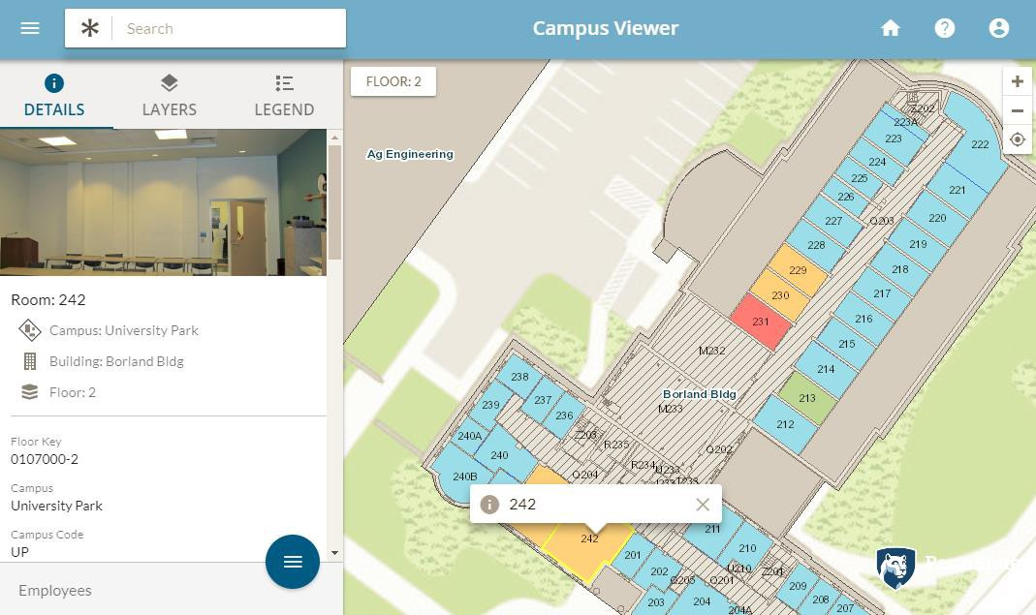
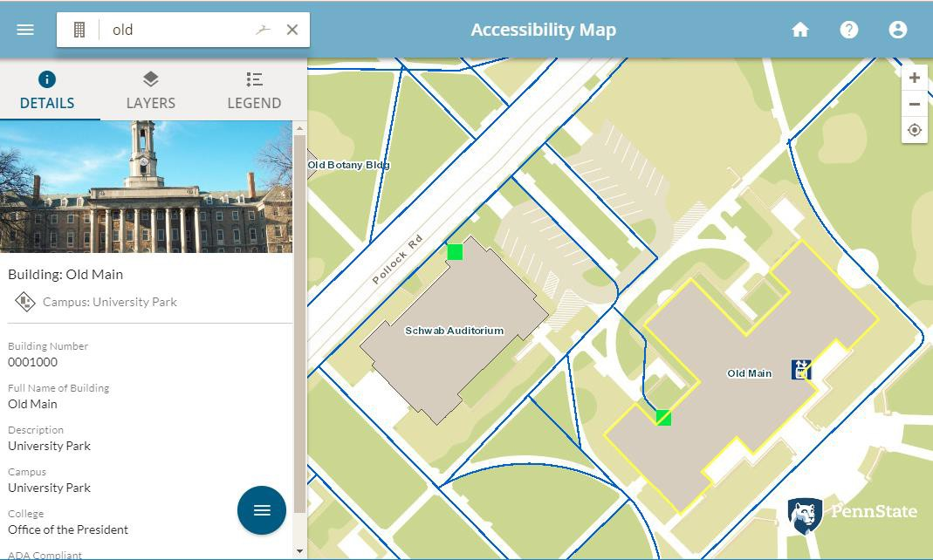
Other Applications
Overview
Campus Viewer
Accessibility Map

Slide 2

Other Applications
Campus Viewer
Provides general READ-ONLY access to information about Facilities
Simple and easy to use, works on Desktop or Mobile
Uses a subset of space information
Key Features:
  Search
  View Details
  Map/Floorplan Interaction
  View Related
  Switch Viewbys
  Print
  Share

Slide 3

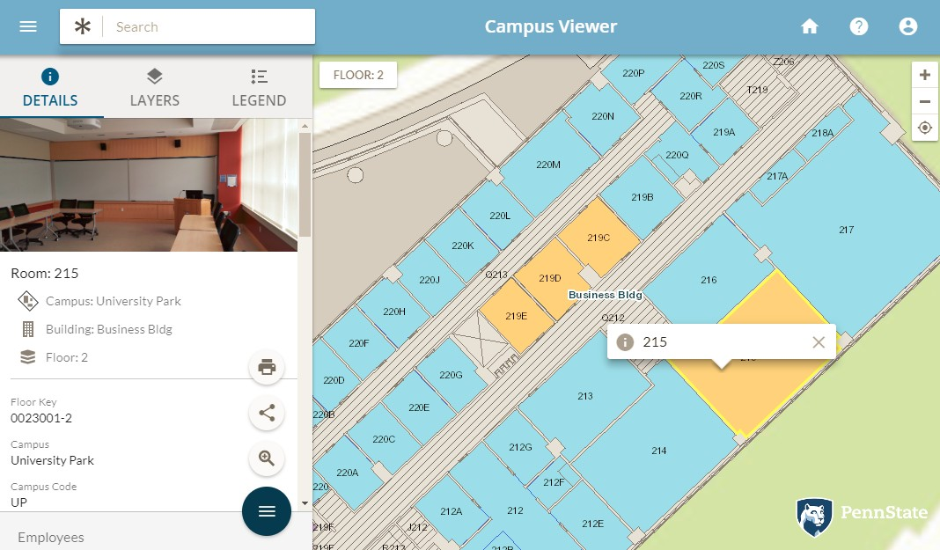
Other Applications
Campus Viewer basics
Search
Floor Picker
Home/Help
Toggle Details
Map Controls
Tab Selector
Popup
Hierarchy
Details
View Related
Actions Menu
Map

Slide 4

Exercise #1: Using the Campus Viewer
From InVision Home, launch the Campus Viewer app
Focus the Search on Buildings, and search for “Borland”
Select the Borland Building
Open Floor 1 in the Borland building
Toggle the Details View to maximize the map. Toggle Details again to see the
Details panel.
Reference the legend to find the ‘Classroom/Laboratory/Study’ spaces, and click
on one of them
From the Actions menu click Share, and copy the link to that classroom
Switch to Floor 2 of the Borland Building, and click on Space 214
View the related employee. Click the Employee name to see Details
Click Home to return to InVision Home

Slide 5

Other Applications
Accessibility Map
Displays READ-ONLY accessibility information
Includes:
  Accessible Routes
  Building Access
  Elevators, Talking Signs
  Building Compliance
Key Features:
Search
View Details
Map/Floorplan Interaction
View Related
Toggle Layer Visibility
Print
Share via link

